Slide 1
Computation and visualization
“Layoff Trend Analysis and Visualization”
Group 3
Atharva Mahajan
Ruchirkanth Gandikota
Prabhat Chanda
Shashank Farkase

Slide 2

Hypothesis and questions to be answered
To uncover the devastating impact of recent layoffs on industries we would investigate into the following questions:
The number of individuals affected by layoffs in various sectors and countries?
The trend of layoffs in different aspects over recent years?
The country hit hardest by job loss?
The month-by-month breakdown of layoffs to reveal patterns and potential future risks?

Slide 3

Data Cleaning Process

Slide 4
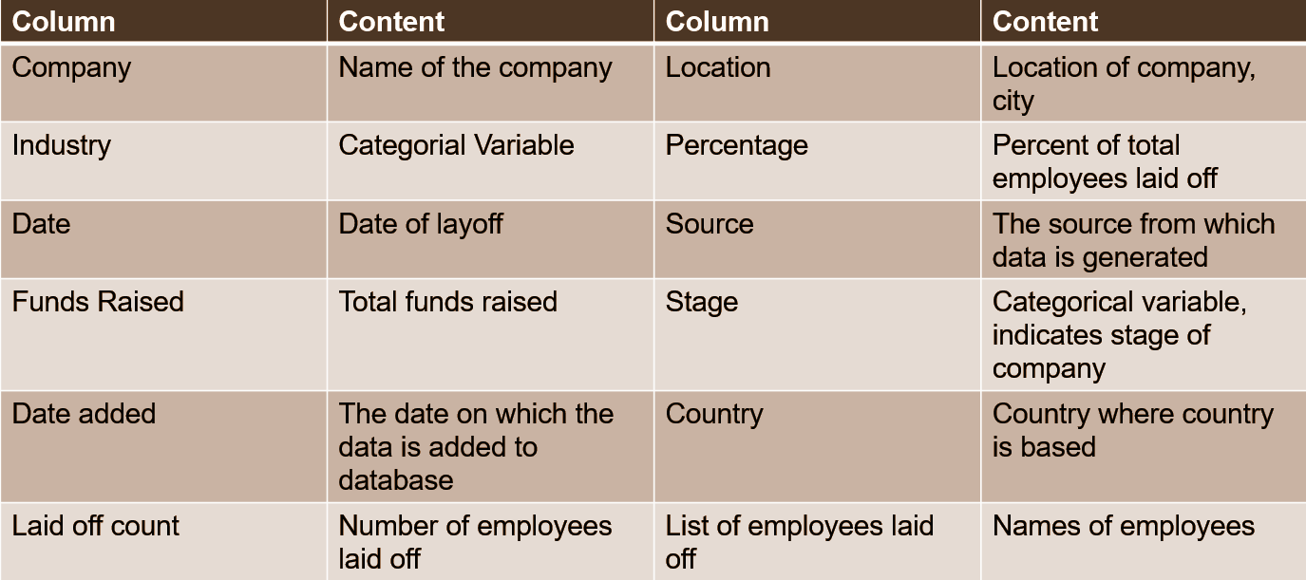
Data Dictionary

Slide 5
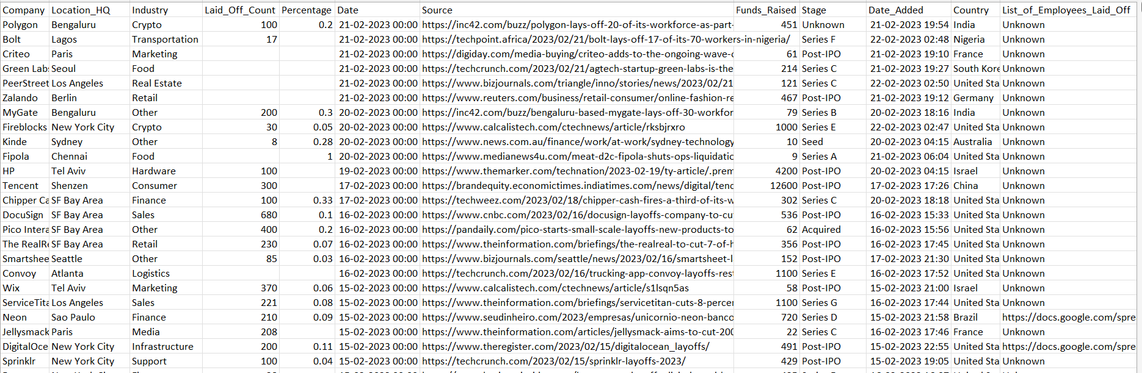
Uncleaned Dataset
Image shows our raw dataset
The dataset has columns which are not useful
It also has null values which must be handled
The dataset has lot of columns which are not useful to use such as Laid_off_employee_list, sources etc.

Slide 6
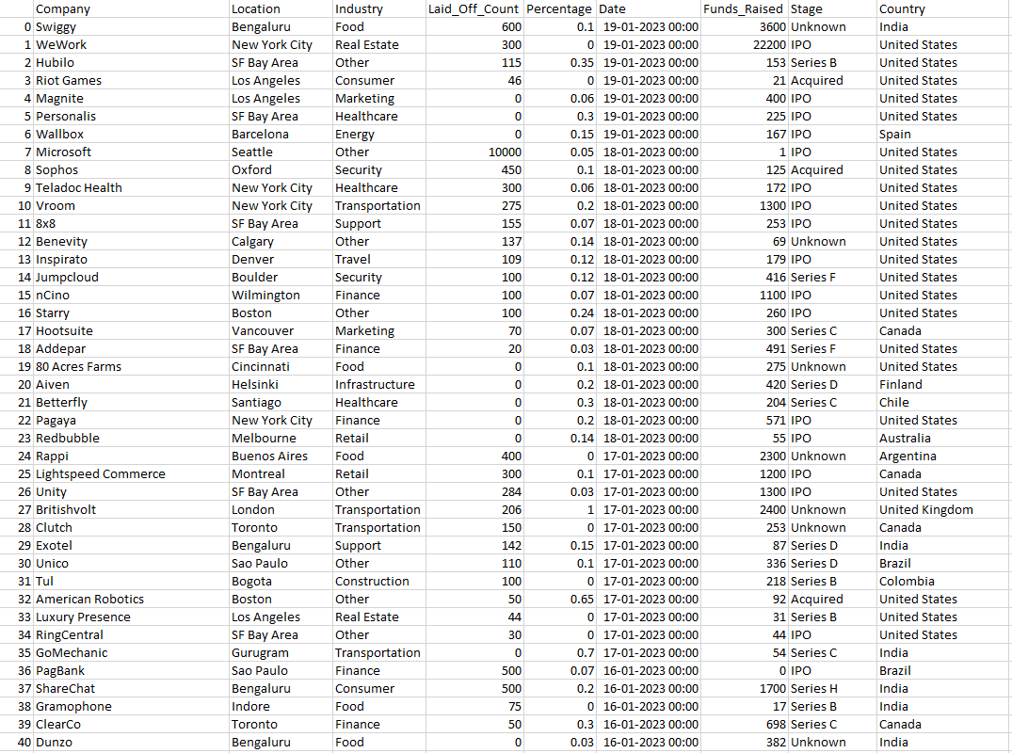
Cleaned dataset
The image shows the cleaned dataset
The columns which are not useful for analysis and visualization have been dropped
The null values have been handled by using multiple cleaning procedures
The finalized dataset has been saved as a new excel file which can now be used for effective visualization

Slide 7
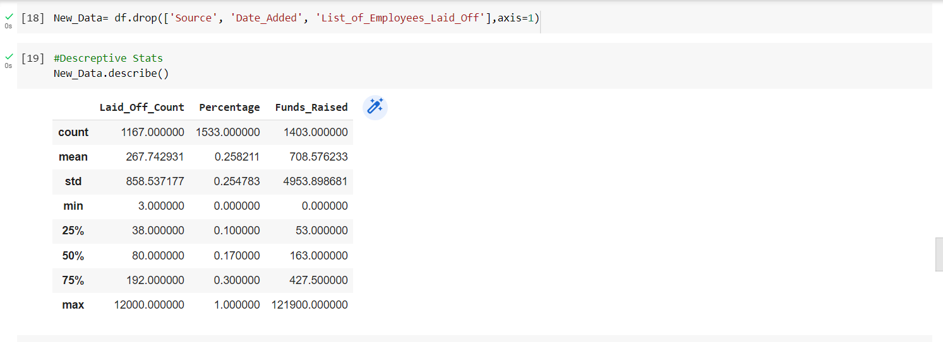
Statistical Descriptive of Dataset
The image shows the descriptive stats of the dataset
The image is giving the stats related to all the numerical columns in the dataset
The table is showing the mean, standard deviation etc. of the data

Slide 8
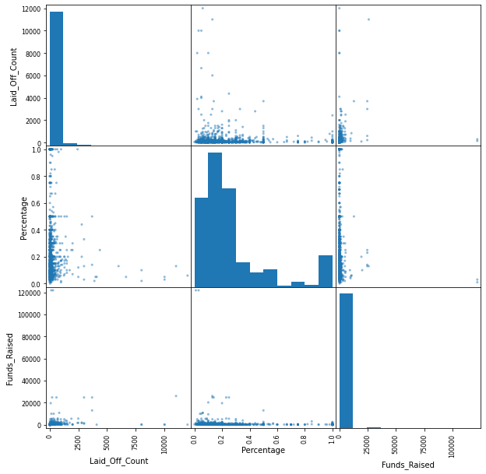
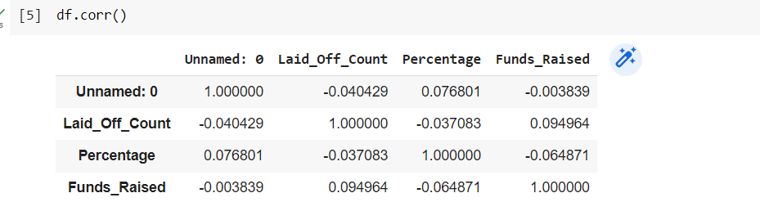
Correlation Matrix and Scatter Matrix
Both the images show the relationship between all the variables in our dataset.
In the above image is scatter matrix which depicts the relationship between our variables
The scatter matrix is showing how 2 variables are related in the dataset
The image below is of correlation matrix which shows how the variables are correlated to each other.
The matrix is also showing the strength and direction of linear relationship between 2 variables.
We can see that –ve value indicates that 2 variable move in opposite direction at same magnitude
And correlation of 1 indicate perfect +ve correlation.

Slide 9
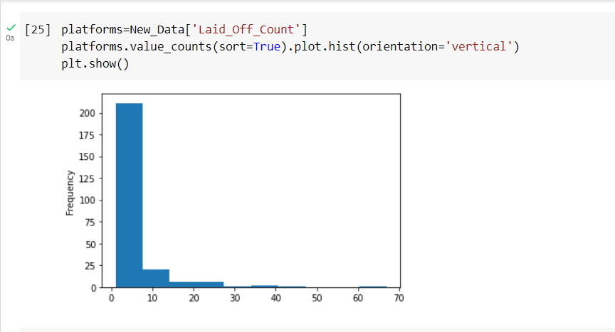
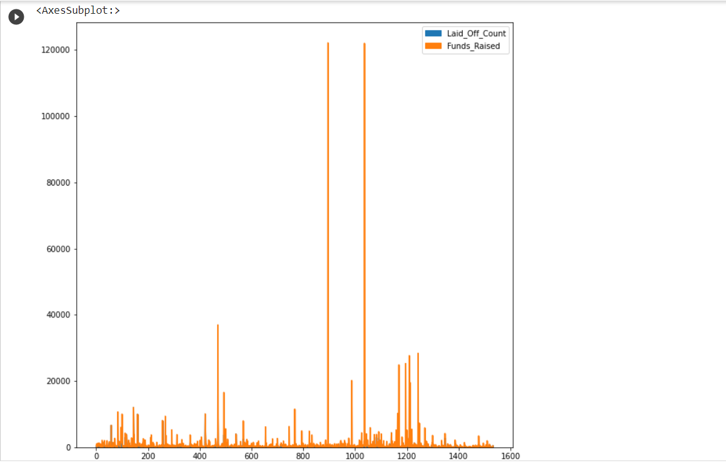
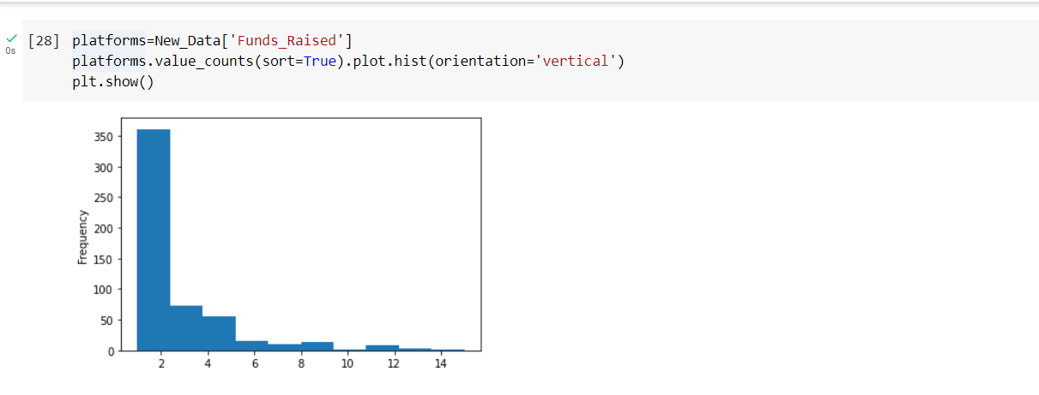
Static Plots
The images show some of the static plots of our data.
The first 2 plots are the histograms which show the frequencies of funds-raised and Laid-Off-Count.
The plot show the cumulative value of laid off count on the Y-axis.

Slide 10
Tableau Dashboard Interactive Visualization

Slide 11
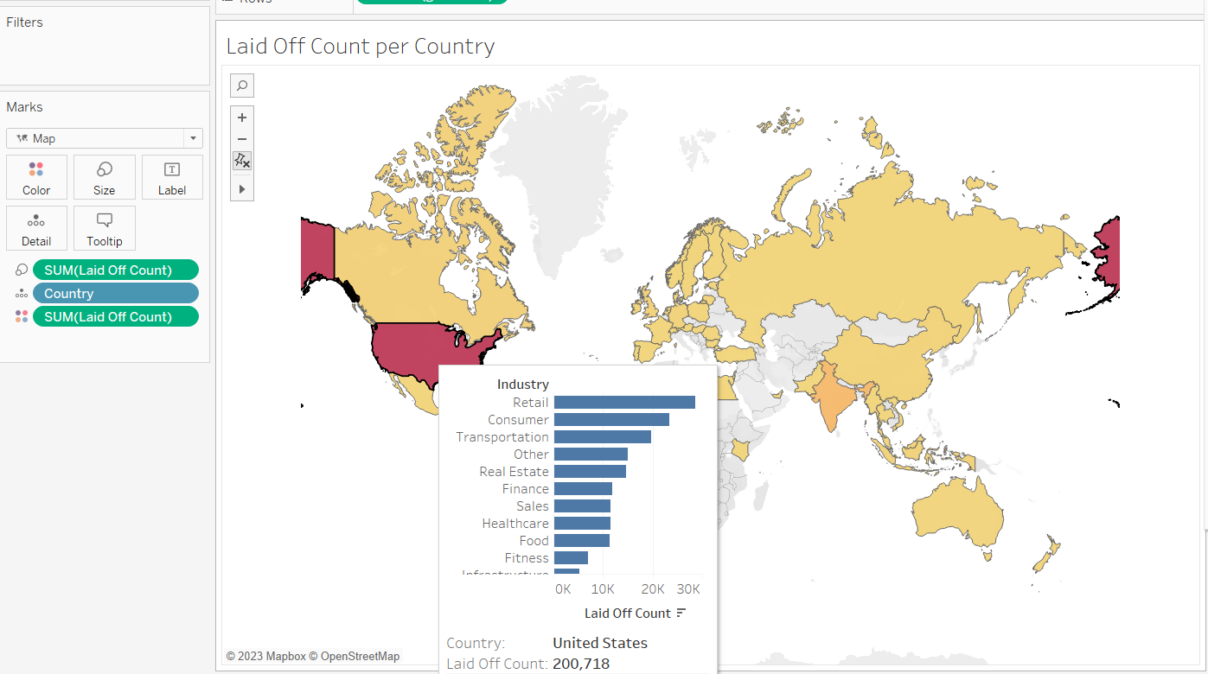
Laid Off Count Per Country
The Dashboard shows the number of laid of employees per country.
The Dashboard presents a stark reality of the global impact of layoffs, with the USA and India being the most affected countries.
This data can inform policy makers, employers, and communities to develop effective recovery strategies.

Slide 12
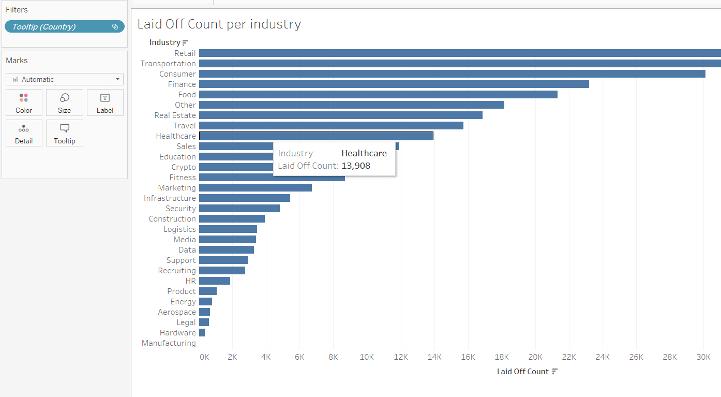
Laid off Count per Industry
This dashboard shows the laid off count per industry.
The most affected industry is retail and the second most is the transportation due to the covid outbreak.
Dashboard also depicts clear picture of number of personals laid-off per industry.

Slide 13
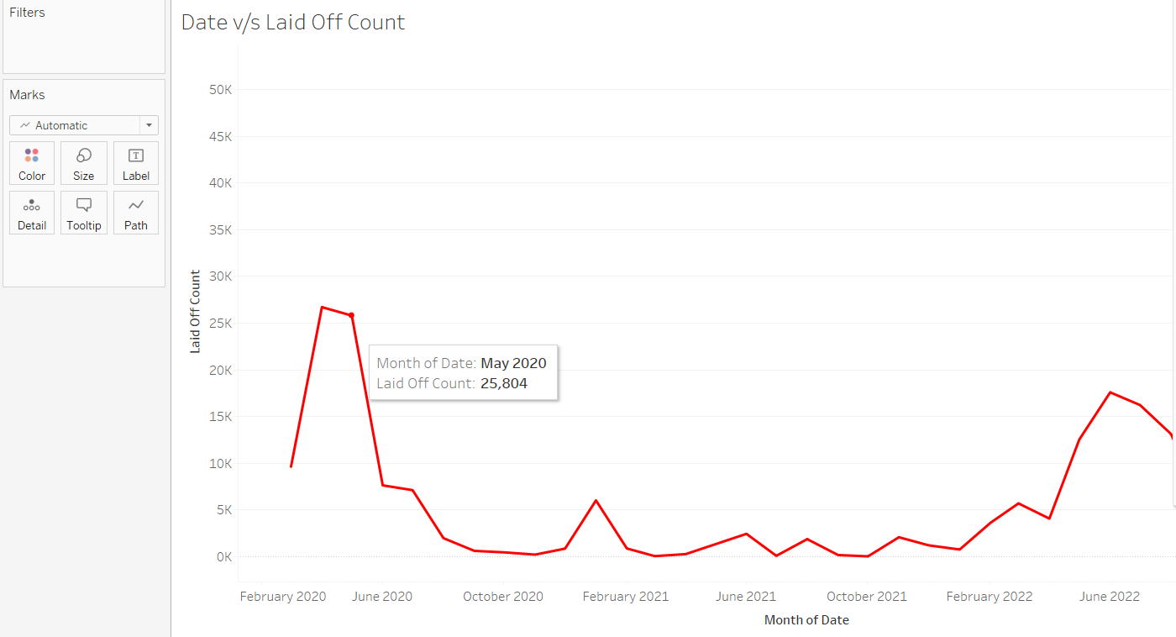
Laid off count Date wise
The dashboard provides a clear and concise view of the number of employees who have been laid off
The data displayed on the dashboard indicates that there were two significant peaks in the layoff count.
The first peak occurred during the initial outbreak of COVID-19 when businesses were forced to shut down and restructure.
The second peak was observed during the mid of 2022, highlighting that the pandemic's effects have continued to impact businesses even after a year.
The data presented on the dashboard can serve as a vital tool for business leaders to assess the impact of the pandemic on their workforce and make informed decisions accordingly.

Slide 14
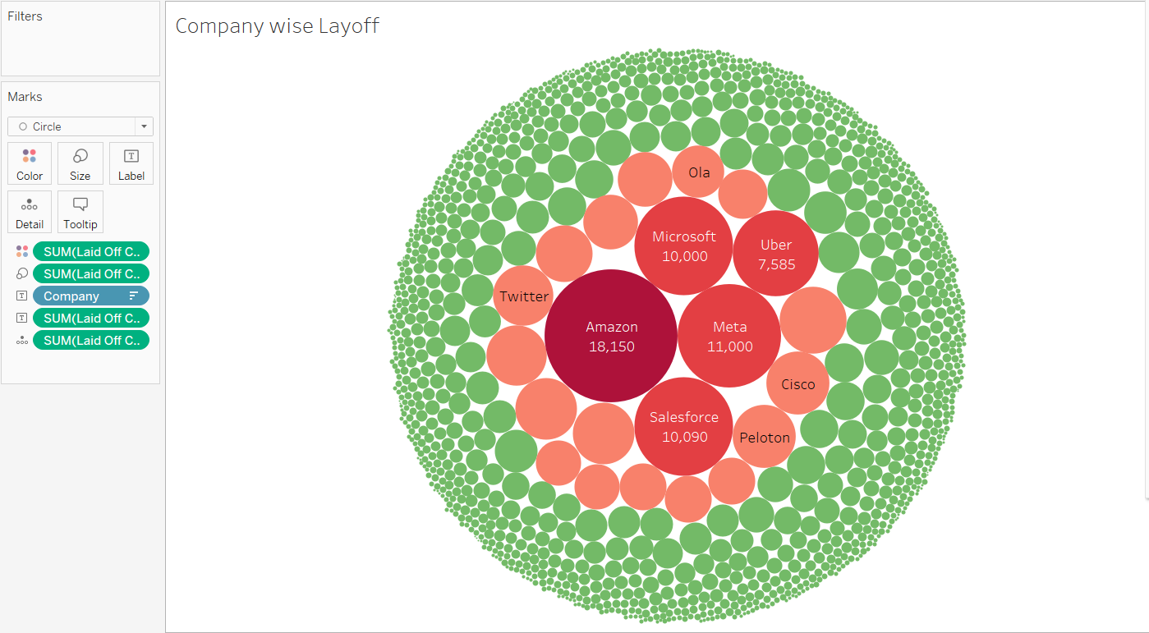
Company-wise Layoff
The dashboard displays the number of employees laid off per company, providing valuable insights into workforce reductions.
The data reveals that Amazon has been hit the hardest by layoffs, indicating significant restructuring or economic challenges.
Meta (formerly known as Facebook) is the second worst affected company, suggesting they have also had to make difficult workforce decisions.

Slide 15
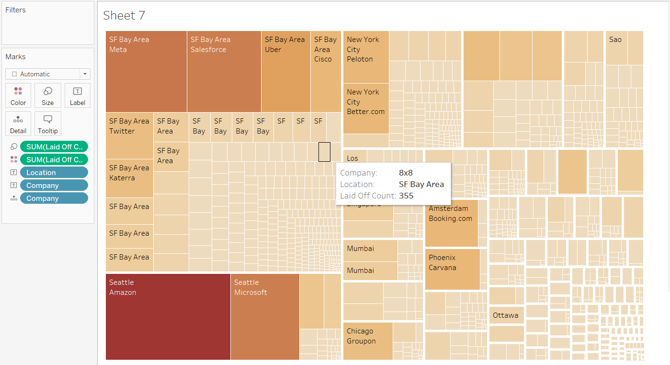
Location wise company layoff
The dashboard displays the relationship between the location and the number of layoffs in different companies.
The data suggests that tech companies have been affected the most by layoffs.
The most common location for layoffs is the San Francisco bay area.
The dashboard provides a clear visualization of the layoff trends in different locations and companies.
This information can be useful for people who are looking for job opportunities or planning to relocate to a different city.

Slide 16
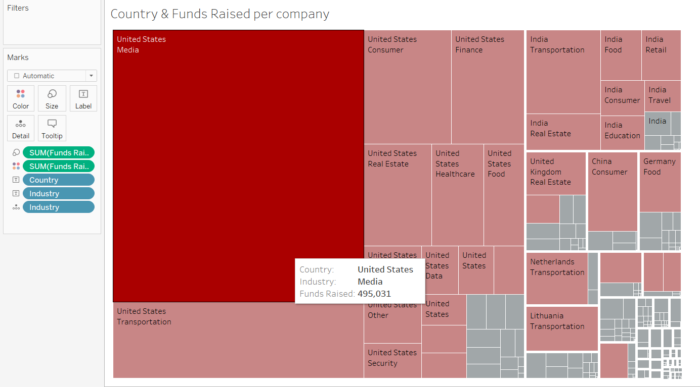
Funds raised by the companies
Dashboard displays country-wise funds raised by the company due to layoffs.
Media industry in USA has raised the highest amount of funds through layoffs.
Other countries and industries also contributed to the funds raised, as shown in the dashboard.

Slide 17
Key Takeaways From The Project
Uncover the devastating impact of layoffs with our data visualization project.
Spanning from 2020 to 2023, our project would paint a comprehensive picture of the industries hit hardest by job loss.
Utilizing Tableau software, the project would provide key insights and trend predictions to anticipate which industries may be at risk in the future.
Help in predicting any future layoff trend

Slide 18
Thank You

